Slide 1
Designing for DynamoDB
Toby Hede
Engineering Manager serverlesspatterns.io @tobyhede
Notes:
DynamoDB is simultaneously the simplest and most complicated database money can buy. A simple key/value table with incredible reliability and essentially boundless capacity can be setup in seconds, but modelling complex access patterns requires careful and considered upfront design planning and consideration. If you have experience with relational systems, DynamoDB requires us to adopt new ways of thinking about how we design and structure our data. This is the story of some of the things I have learned by doing DynamoDB wrong.

Slide 2
Hello I’m Toby

Slide 3
The Plan
Some facts about DynamoDB
That one time I made a relational model in DynamoDB
How to do DynamoDB better

Slide 4

What is DynamoDB
Amazon DynamoDB is a key-value and document database that delivers single-digit millisecond performance at any scale. It's a fully managed, multi-region, multi-master database with built-in security, backup and restore, and in-memory caching for internet-scale applications.

Slide 5
Core Concepts
Tables
Items + Attributes
Keys
Partition Key
Sort Key
Secondary Indexes
Read + Write Capacity

Slide 6

Distributes
Data
Flexible
Schema

Slide 7







A
B
C

Slide 8
A

Slide 9
Read
Write
A1
A2
Notes:
Eventually consistent reads

Slide 10
Read
Write
A2
A2
Notes:
Strongly consistent reads

Slide 11
Indexes
Alternate Partition and/or Sort Key

Slide 12
Partition
Sort
Index

Slide 13
Capacity
ReadCapacity = ceil(ItemSize/4) * DesiredReadsPerSecond
WriteCapacity = ceil(ItemSize/4) * DesiredWritesPerSecond
Just let Amazon do it

Slide 14
Lets start modelling
Items
Keys
Attributes
How hard can it be?

Slide 15


No Joins
Customer
Orders
Products
Get all the Customers
For each Customer get the Orders
For each Order get the Products

Slide 16
NO
NO
NO
NO
NO
NO
NO
NO
NO

Slide 17
Forget everything you may know about relational databases

Slide 18
Two Rules
Design to optimise query patterns
You probably only need one table

Slide 19
Design to optimise query patterns
Design the schema for access, not data structure
Data structures evolve from the problem you are solving
You need to know the questions you will need to answer.
Notes:
In RDBMS, you design for flexibility without worrying about implementation details or performance. Query optimization generally doesn't affect schema design, but normalization is very important.
In DynamoDB, you design your schema specifically to make the most common and important queries as fast and as inexpensive as possible. Your data structures are tailored to the specific requirements of your business use cases.

Slide 20
SELECT * FROM
A single query returns multiple entities
Single round-trip

Slide 21
A quick note on syntax
SELECT * FROM invoices WHERE id = ‘INV0001’
dynamodb get-item –table-name invoices --key ‘{ “id": {"S": "INV0001}'
dynamodb query --table-name invoices --key-condition-expression "id = :id"
--expression-attribute-values '{ ":id": {"S": "INV0001"}}'

Slide 22
An example from an actual thing we did
Track Invoices so a Customer can view and download

Slide 23
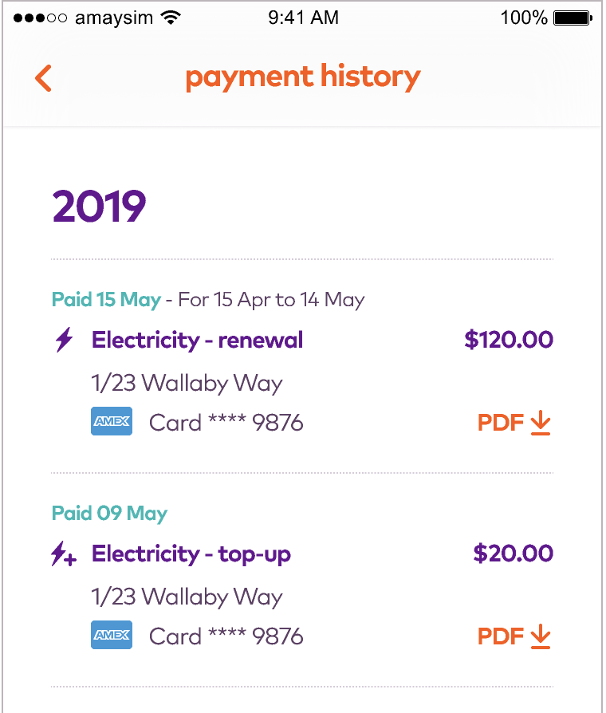
Invoices for An Account
By Date

Slide 24
No Key
Or Index
Partition
Key
Id | AccountNumber | Date | Status
INV0001 | AC000001 | 2019-04-01 | Paid
INV0002 | AC000001 | 2019-05-01 | Paid
INV0003 | AC000002 | 2019-05-01 | Due
SELECT * FROM invoices WHERE id = ‘INV0001’
SELECT * FROM orders WHERE AccountNumber =‘AC000001’ ORDER BY Date

Slide 25
Partition
Key
Sort Key
Account Number | Date | InvoiceNumber | Status
AC000001 | 2019-04-01 | INV0001 | Paid
AC000001 | 2019-05-01 | INV0002 | Paid
AC000002 | 2019-05-01 | INV0003 | Due
SELECT * FROM invoices WHERE AccountNumber = ‘AC000001’
Sort order is implicit

Slide 26
But what if …
I need to find a specific Invoice?

Slide 27
Global
Secondary
Index
Account Number | Date | InvoiceNumber | Status
AC000001 | 2019-04-01 | INV0001 | Paid
AC000001 | 2019-05-01 | INV0002 | Paid
AC000002 | 2019-05-01 | INV0003 | Due
SELECT * FROM invoices WHERE InvoiceNumber = ‘INV0001’

Slide 28
Lets Model an Online Store
Customer => Order

Slide 29
What are our queries?
Find an Order
Find all the Orders with a {status}
Find all the Orders with {status} for a {date}
Find a Customer
Find all the Customers
Find all the Delivered Orders for a Customer

Slide 30
Partition
Key
Id | CustomerId | Date | Status
order-0001 | customer-0001 | 2019-04-01 | delivered
order-0002 | customer-0001 | 2019-05-01 | pending
order-0003 | customer-0002 | 2019-05-01 | ready
SELECT * FROM orders WHERE Id = ‘order-0001’
SELECT * FROM orders WHERE customerId = ‘customer-0001’
SELECT * FROM orders WHERE status = ‘delivered’
SELECT * FROM orders WHERE date = ‘2019-05’

Slide 31
Generic Attributes
partition | sort
partition and sort keys will be overloaded

Slide 32
find an order
partition | sort
order-01 | order
SELECT * FROM orders WHERE partition = ‘order-01’

Slide 33
find a customer
Use a
Transaction
partition | sort
order-01 | order
customer-01 | customer
Transaction Write API
SELECT * FROM store WHERE partition = ‘customer-01’

Slide 34
find all orders for a customer
partition | sort
order-01 | order
customer-01 | customer
customer-01 | order-01
SELECT * FROM store WHERE partition = ‘customer-01’

Slide 35
find all customers
partition | sort
customer-01 | customer
customer-02 | customer
customer-03 | customer
SELECT * FROM store WHERE sort = ‘customer’

Slide 36
find all orders
partition | sort
order-01 | order
order-02 | order
order-03 | order
SELECT * FROM store WHERE sort = ‘order’

Slide 37
find all orders with {status}
partition | sort
order-01 | order
customer-01 | customer
SELECT * FROM store WHERE ? = ‘?’

Slide 38
Add an Index
partition | sort/gsi-1-partition | gsi-1-sort
This is about to get very confusing
Primary Key == sort/gsi-1-partition
Sort Key === gsi-1-sort

Slide 39
find all orders with {status}
partition | sort/gsi-1-partition | gsi-1-sort
order-01 | order | ready
order-02 | order | delivered
order-03 | order | ready
SELECT * FROM gsi-1 WHERE
sort/gsi-1-partition = ‘order’ AND
gsi-1-sort = ‘delivered '

Slide 40
find all the orders with {status} for {date}
partition | sort/gsi-1-partition | gsi-1-sort
order-0001 | order | ready
order-0002 | order | delivered
order-0003 | order | ready
Oh no

Slide 41
find all the orders with {status} for {date}
partition | sort/gsi-1-partition | gsi-1-sort
order-01 | order | delivered/2019-05-01
order-02 | order | ready/2019-05-01
order-03 | order | pending/2019-05-05
SELECT * FROM gsi-1 WHERE
sort/gsi-1-partition = ‘order’ AND
gsi-1-sort BEGINS ‘delivered/2019-05 '

Slide 42
find all the orders with {status} for {date} range
partition | sort/gsi-1-partition | gsi-1-sort
order-01 | order | delivered/2019-05-01
order-02 | order | ready/2019-05-01
order-03 | order | pending/2019-05-05
SELECT * FROM gsi-1 WHERE
sort = ‘order’ AND
gsi-1-sort BETWEEN ‘delivered /2019-05-01’ AND ‘delivered/2019-05-03’

Slide 43
find all the orders for {date}
partition | sort/gsi-1-partition | gsi-1-sort
order-01 | order | delivered/2019-05-01
order-02 | order | ready/2019-05-01
order-03 | order | pending/2019-05-01
SELECT * FROM gsi-1 WHERE sort = ‘order’ AND gsi-1-sort BEGINS ‘delivered/2019-05'
SELECT * FROM gsi-1 WHERE sort = ‘order’ AND gsi-1-sort BEGINS ‘pending/2019-05'
SELECT * FROM gsi-1 WHERE sort = ‘order’ AND gsi-1-sort BEGINS ‘ready/2019-05'

Slide 44
Add another Index
find all the orders for a month
partition | sort/gsi-1-partition/gsi-2-partition | gsi-1-sort | gsi-2-sort
order-01 | order | ready | 2019-05-01
order-02 | order | delivered | 2019-05-02
order-03 | order | ready | 2019-05-03
SELECT * FROM gsi-2 WHERE
sort/gsi-1-partition/gsi-2-partition = ‘order’ AND
gsi-2-sort BEGINS ‘2019-05 '
Indexes increase cost (latency and $)

Slide 45
find all the orders with {status} for {date}
partition | sort/gsi-1-partition/gsi-2-partition | gsi-1-sort | gsi-2-sort
order-01 | order | ready | 2019-05-01
order-02 | order | delivered | 2019-05-02
order-03 | order | ready | 2019-05-03
SELECT * FROM sort-data-index WHERE
sort/gsi-1-partition = ‘order’ AND
gsi-1-sort = ‘delivered ‘
gsi-2-sort = ‘2019-05 '
We can’t combine GSIs

Slide 46
so of course …
partition | sort/gsi-1-partition/gsi-2-partition | gsi-1-sort | gsi-2-sort
order-01 | order | ready/2019-05-01 | 2019-05-01
order-02 | order | delivered/019-05-02 | 2019-05-02
order-03 | order | ready/2019-05-03 | 2019-05-03
Shape the data to the query

Slide 47
THIS ALL SEEMS SO HARD ...

Slide 48
Notes:
23 access patterns using only THREE GSIs.

Slide 49
When to DynamoDB
serverless key-value state
low-latency
multi-region resiliency
scale

Slide 50
Just watch this
AWS re:Invent 2019:
Amazon DynamoDB Deep Dive:
Advanced Design Patterns for DynamoDB

Slide 51
And read this
Takeaways from AWS re:Invent 2019’s Amazon DynamoDB Deep Dive: Advanced Design Patterns (DAT403)

Slide 52
And this
dynamodbguide.com

Slide 53
Thank You
serverlesspatterns.io
@tobyhede

Slide 54
find all the customers for a location
partition | sort/gsi-1-partition | gsi-1-sort
customer-01 | customer | phl/manila
customer-02 | customer | au/nsw/sydney
SELECT * FROM gsi-1 WHERE gsi-1-partition = ‘customer’ AND gsi-1-sort BEGINS WITH ‘phl/'
SELECT * FROM gsi-1 WHERE gsi-1-partition = ‘customer’ AND gsi-1-sort BEGINS WITH ‘au/nsw/'

Slide 55
find all the orders for a customer
partition | sort/gsi-1-partition | gsi-1-sort
order-01 | order | delivered
order-01 | customer-01
order-02 | customer-01
Transaction Write API
SELECT * FROM shop WHERE partition = ‘order-01’
Returns all of the data for an order

Slide 56
find all the orders for a customer
Use a
Transaction
partition | sort/gsi-1-partition | gsi-1-sort
order-01 | order | delivered
order-01 | customer-01 | …
order-02 | customer-01 | delivered
SELECT * FROM gsi-1 WHERE sort/gsi-1-partition = ‘customer-01’
“partition” on the index is “sort” on the table

Slide 57
find all the orders for a customer
Use a
Transaction
partition | sort/gsi-1-partition | gsi-1-sort
order-01 | order | delivered
order-01 | customer-01 | …
order-02 | customer-01 | delivered
SELECT * FROM gsi-1 WHERE sort/gsi-1-partition = ‘customer-01’
Transaction Write API
“partition” on the index is “sort” on the table

Slide 58
But wait … there’s more
Customer => Order

Slide 59
track all the products in an order
partition | sort/gsi-1-partition | gsi-1-sort
order-01 | order | delivered/2019-05-01
order-01 | product-01 | 10.00
order-01 | product-02 | 42.00

Slide 60
find all the orders containing a product
partition | sort/gsi-1-partition | gsi-1-sort
order-0001 | order | delivered/2019-05-01
order-0001 | product-0001 | 10.00
order-0001 | product-0002 | 42.00
SELECT * FROM sort-data-index WHERE partition = ‘product-0001’

